Slide 1

Chinook Music Sales Analysis
Exploring Music Sales with Data ntelligence
Name - Hemlata Gund
Date - 20/7/25

Slide 2
Problem Statement
Ensure data integrity by identifying and handling missing values and duplicates.
Discover top-selling tracks, artists, and genres in both USA and global markets.
Analyze customer demographics and purchasing behavior, including churn rate and frequency.
Calculate total revenue and identify top customers by geographic region.
Recommend albums for promotion based on genre sales and customer interests.

Slide 3



Dataset & Tools
Chinook MySQL database
Tools used: MySQL Workbench,MSExcel, PowerPoint
Tables used: Customers, Invoice, Invoice Line, Tracks, Artists, Albums, Genres, Employee, Playlist, Playlist track, Media Type.

Slide 4
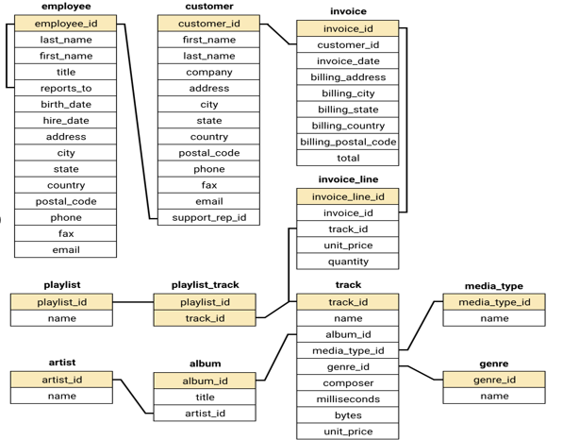
Database Schema

Slide 5
Data Quality Check
Missing values (example: NULL)
Identify and address missing values and duplicates to ensure data integrity.
Handled duplicates and nulls
Ensured relational integrity across joins
Checked for NULLs and duplicates in key tables like customer, track, and invoice.
No duplicates found and no critical missing values found in customer names or invoice
totals.
Overall, the database is clean and reliable for analysis.

Slide 6
Total Revenue and Invoice Count by Region
Revenue and invoice data was grouped by billing country, state, and city using the invoice table.
Czech Republic (Prague) generated the highest revenue at $273.24 from 30 invoices.
Other top-performing cities include Mountain View (USA) and London (UK).
Notable European markets like Berlin, Paris, and Dublin also show strong revenue.
This breakdown helps identify geographic hotspots for physical music sales and strategic market expansion.
Custom Combination Chart

Slide 7
Top-Selling Tracks, Artists & Genres
Insights:
Genre Popularity: Rock is the dominant genre with the highest total sales figures. The top two albums belong to this genre, indicating a strong market preference for Rock music in the USA.
Sales Figures: The selected albums have the highest total genre sales, making them strong candidates for promotion.
Given the strong sales performance of these albums in the Rock genre, they should be prioritized for advertising and promotion in the USA to capitalize on their popularity.

Slide 8
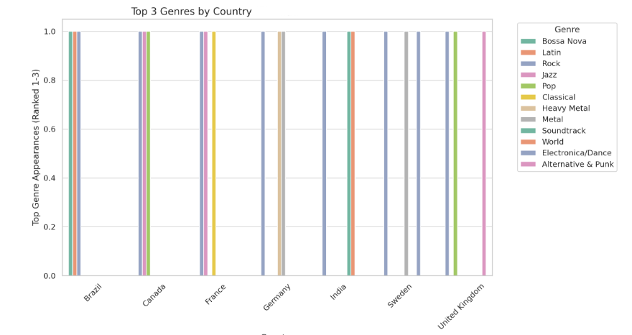
Comparison with the USA market
Commonalities:
Rock dominates in almost all the countries listed, indicating a strong global preference for Rock music outside the USA.
Metal and Alternative & Punk are also popular in Brazil, showing a more diverse taste in music genres in that country.
Rock is the top genre in every country mentioned except for the specific instances where Metal or Alternative & Punk are highlighted.
Differences:
Brazil stands out with significant sales in both Alternative & Punk and Metal genres, in addition to Rock, showing a more varied musical taste compared to other countries.
Metal has a notable presence in Canada and Brazil but does not appear as a top genre in other countries listed.
The sales volume for genres other than Rock is generally lower in all non-USA countries, indicating Rock’s dominance.

Slide 9
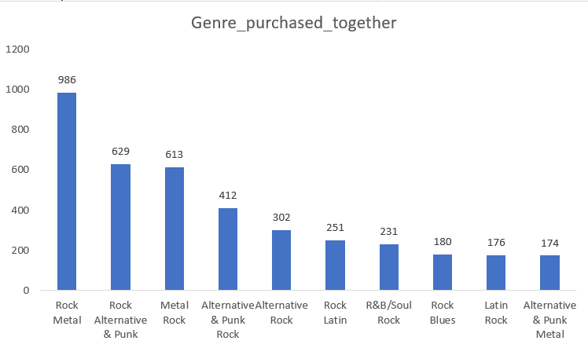
Genre Purchased Together
Insights:
Metal and Rock are the most frequently purchased together, indicating a strong overlap in fan base.
Alternative & Punk and Rock also show significant co-purchase rates, suggesting shared listener preferences.
Latin and R&B/Soul genres have notable pairings with Rock, pointing to potential opportunities for cross-genre promotions.
Recommendations:
Bundle Offers: Combine Metal and Rock albums, along with Alternative & Punk with Rock for popular bundles.
Cross-Promotions: Promote Metal albums to Rock fans and vice versa, leveraging their shared appeal.

Slide 10
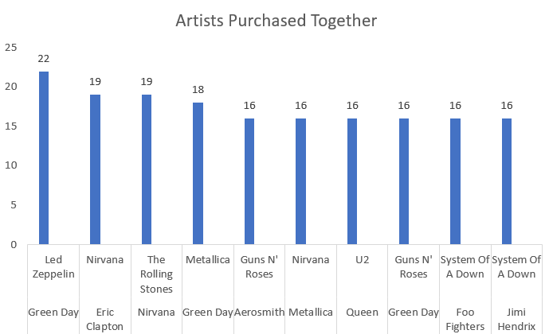
Artists Purchased Together
Insights:
Green Day and Led Zeppelin are frequently purchased together, indicating strong cross-genre appeal.
Nirvana and The Rolling Stones, as well as Eric Clapton and Nirvana, show notable co-purchase patterns, suggesting these artist pairings resonate with similar audiences.
Artists like System Of A Down and Foo Fighters, and Queen and The Police, also have significant co-purchases, highlighting popular combinations among listeners.
Recommendations:
Artist Pairing Promotions: Offer discounts on Green Day and Led Zeppelin albums purchased together and apply similar deals to pairings like Eric Clapton and Nirvana.

Slide 11
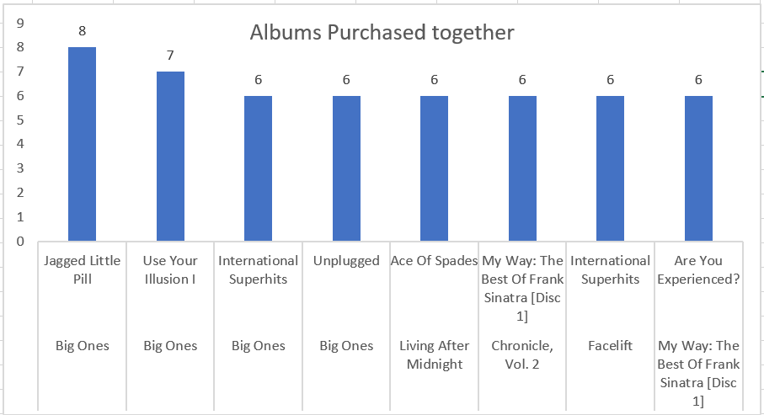
Albums Purchased Together
Insights:
“Big Ones" is a popular album paired with several others, including “Jagged Little Pill" and “Use Your Illusion" indicating it resonates well with fans of diverse classic rock albums.
Albums like "The Police Greatest Hits" and "My Generation - The Very Best Of The Who" frequently appear together, suggesting a strong preference for classic rock compilations.
Album Pair Deals: Offer combined deals on album pairs like “Big Ones" and “Jagged Little Pill“.
Special Editions: Create box sets with frequently paired albums to attract collectors.

Slide 12
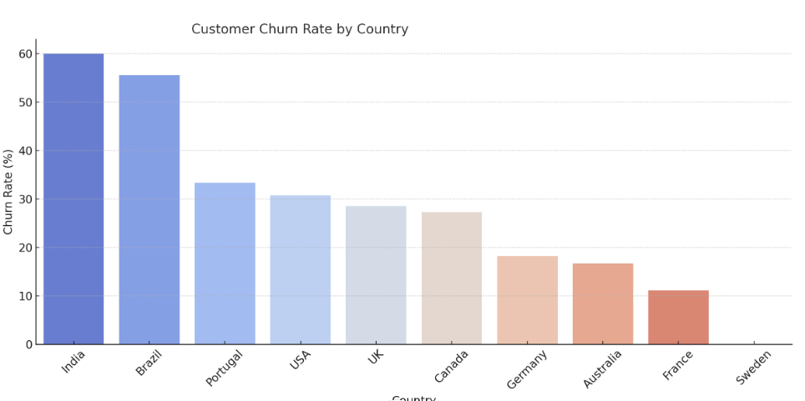
Comparing Churn Rates by Country
Churn Rates:
-Brazil shows the highest churn rate (~56%), possibly due to economic sensitivity or genre mismatch.
-USA and India also have moderate churn.
-Sweden, Germany, and Australia show low churn, indicating strong customer loyalty.
Insight: High churn suggests a need for better customer retention strategies, such as loyalty programs and enhanced support.
Recommendations:
Moderate Churn rate Areas: Enhance engagement with loyalty programs and value offers.
High Churn rate Areas: Address churn with discounts, improved service, and feedback collection

Slide 13
Conclusion & Strategic Recommendations
Rock is the highest-grossing genre globally and in the USA.
Long-term customers contribute significantly more to revenue than short-term ones.
High churn detected in several low-engagement countries.
Top customers are concentrated in a few key markets (e.g., Czech Republic, Ireland).
Recommendations
Focus promotions on top-selling albums in Rock, Alternative & Metal genres.
Re-engage churned customers through targeted campaigns in high-churn countries.
Prioritize long-term customer retention through loyalty rewards and personalized offers.
Monitor churn trends monthly to proactively target at-risk segments.
“Data-driven strategies can maximize sales and enhance customer loyalty for Chinook.”

Slide 14
Thank you

